Slide 1
Lecture 2

Slide 2
Content
Attributes and functions of a practicing engineer
Engineer as a problem solver
Engineer as a designer
Engineer as a change agent

Slide 3
Attributes and functions of a practicing engineer
Who is a Practicing Engineer?
Importance of engineers in modern society
Scope: From concept to reality – transforming ideas into practical solutions

Slide 4
Who is a Practicing Engineer
A practicing engineer is someone who applies engineering principles to solve real-world problems and is actively involved in the engineering profession
A practicing engineer can be a Professional Engineer (PE) who is licensed to offer engineering services to the public or someone who is gaining experience under the supervision of a PE.

Slide 5
Key Attributes of a Practicing Engineer
Technical Proficiency – Mastery in core engineering principles
Ethical Integrity – Adheres to codes of ethics and professional conduct
Problem Solving Skills – Analytical and innovative mindset
Communication Skills – Effective oral and written communication
Teamwork and Collaboration – Works well in multidisciplinary teams
Adaptability and Lifelong Learning – Stays updated with technological advancements

Slide 6
Additional Attributes
Project Management Skills – Planning, executing, and leading projects
Decision Making under Constraints – Balancing cost, time, quality, and safety
Social and Environmental Responsibility – Understanding sustainability and societal impact
Leadership Qualities – Influencing, guiding, and mentoring others

Slide 7
Core Functions of a Practicing Engineer
Design and Development – Creating products, processes, or systems
Analysis and Testing – Evaluating performance and ensuring quality
Implementation and Operation – Overseeing production and daily functions
Maintenance and Support – Ensuring long-term functionality

Slide 8
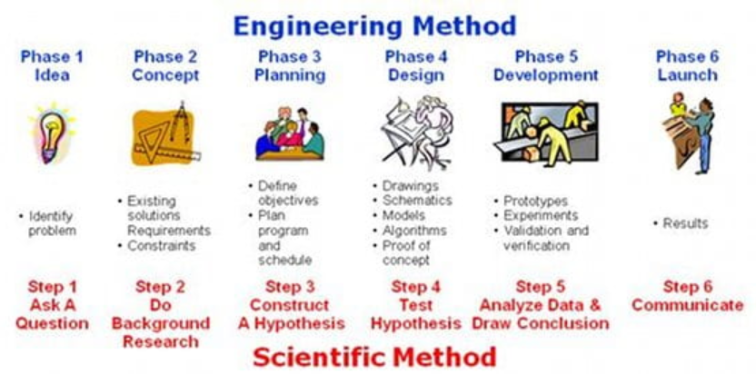
Engineer as a problem solver

Slide 9
Engineer as a designer
The engineering design process is a series of steps that engineers follow to find a solution to a problem. The steps include problem solving processes such as, for example, determining your objectives and constraints, prototyping, testing and evaluation.

Slide 10
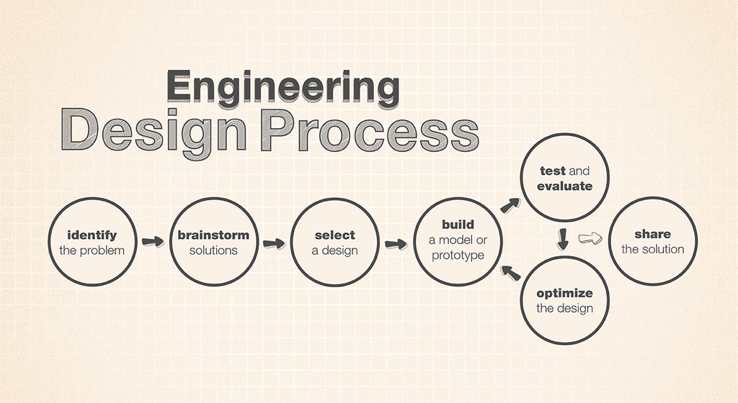

Slide 11
Engineer as a change agent
A change agent is someone who:
Identifies areas for improvement
Initiates innovation
Implements new solutions
Influences others toward positive transformation

Slide 12
Engineer as a Change Agent: Key Aspects
1. Technological Transformation
Engineers introduce new technologies (e.g., AI, renewable energy, electric vehicles).
Example: Electrical engineers helped shift from fossil fuels to solar and wind power, transforming the energy sector.
2. Solving Societal Challenges
Engineers design systems to solve global issues like clean water, climate change, healthcare access.
Example: Engineers Without Borders (EWB) works to design low-cost water purification systems in rural areas.
3. Sustainable Development
Engineers promote eco-friendly designs and sustainable practices.
Example: Green buildings, biodegradable materials, and energy-efficient transport systems.

Slide 13
4. Economic Growth
By developing efficient products and systems, engineers boost productivity and economic development.
Example: Automation in manufacturing has revolutionized global supply chains.
5. Digital Innovation
Engineers are central to the digital revolution, creating smart systems and AI-based solutions.
Example: Software engineers developing health apps that monitor and predict disease.
6. Disaster Management & Recovery
Engineers help design systems for early warning, rescue operations, and rebuilding.
Example: Structural engineers redesign buildings to be earthquake-resistant.

